Slide 1



TERM
PROJECT
Subtitle: Gym Workout DB Application
Presented by: João Gabriel Garçon Ribeiro
Course: PROG1121J Database Programming
Date: June 2024

Slide 2

Agenda
Introduction
Purpose of the project
Business Rules
Database Design
Screens
Lessons learned

Slide 3


Why workouts?
This app's inspiration came from my experience as a regular gym-goer. I often found it challenging to keep track of my workout routines. I initially created a simple tool using Notion to record my exercises and address this. This essential tool proved to be incredibly helpful for organizing my workouts.
Given its usefulness, I decided to base my database programming project on this idea. I aimed to develop a more sophisticated and robust application that could eventually evolve into a real, fully functional app.

Slide 4
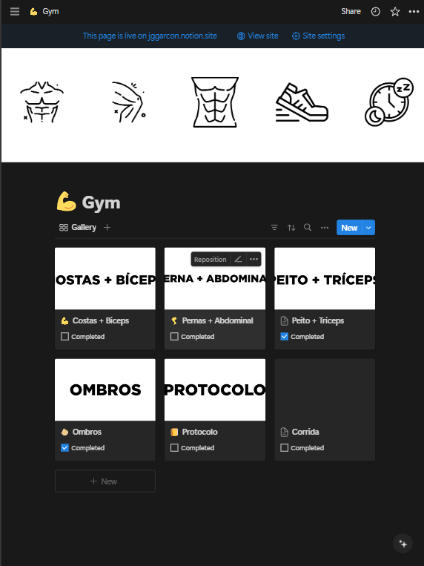
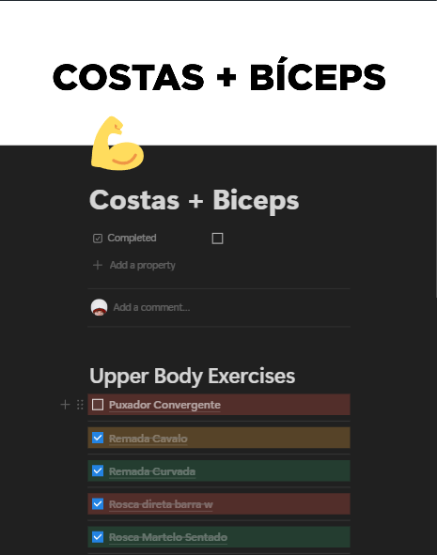
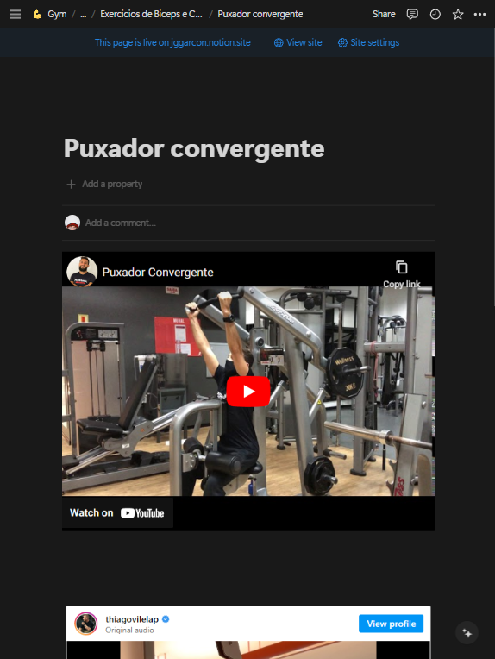
Inspiration
Some screenshots of my Notion app

Slide 5





Business Rules
+
LOGIN
CREATE
READ
UPDATE
DELETE

Slide 6

Login
User
The user must log in with his/her username and password to use the application.

Slide 7


Workout
+
CREATE
To create a new workout, the user must:
Provide Workout title.
Click on the save button.
UPDATE
To update an existing workout, the user must:
Provide Workout title.
Press the save button.
DELETE
To delete an existing workout, the user must:
Open the desired maintenance entity window
Browse for the desired record
Click the Delete button.

Slide 8
Exercise
+
CREATE
• To create a new exercise, the user must:
Provide Exercise title.
Provide Exercise description.
Provide Exercise instructions.
Click on the save button.
UPDATE
To update an existing exercise, the user must:
Provide Exercise title.
Provide Exercise description.
Provide Exercise instructions.
Click on the save button.
DELETE
To delete an existing exercise, the user must:
Open the desired maintenance entity window.
Browse for the desired record.
Click the Delete button.

Slide 9
Muscle
+
CREATE
• To create a new muscle, the user must:
Provide Muscle name.
Click on the save button
UPDATE
To update an existing muscle, the user must:
Provide Muscle name.
Click on the save button.
DELETE
To delete an existing muscle, the user must:
Open the desired maintenance entity window.
Browse for the desired record.
Click the Delete button.

Slide 10

Browse
READ
To browse for related records, the user must:
To see the related data, the user must select either a workout, an exercise, or a muscle from the dropdown menu.
To browse for single tables
Go to browse records
Click on the button related to the desired table name.

Slide 11
DATABASE DESIGN

Slide 12
Entities
User
Relates with Workout
Workout
Muscle
Exercise
Relates to WorkoutExercise and User
Relates to ExerciseMuscle
Relates to WorkoutExercise and ExerciseMuscle
WorkoutExercise
ExerciseMuscle
Relates to Workout and Exercise. Created to solve n-to-n relationship between Workout and Exercise
Relates to Exercise and Muscle. Created to solve n-to-n relationship between Exercise and Muscle

Slide 13
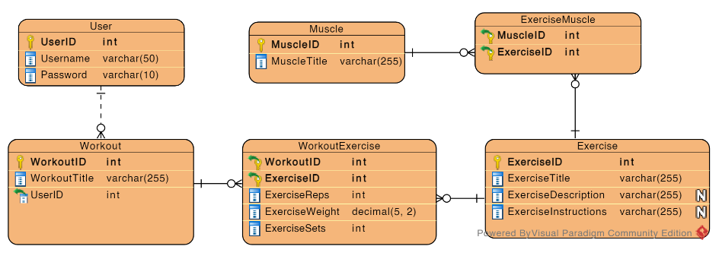
ERD

Slide 14
SCREENS

Slide 15
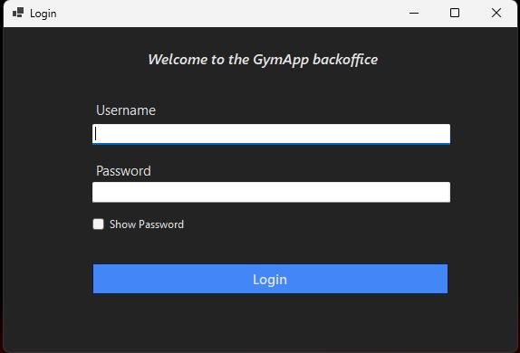
Login

Slide 16
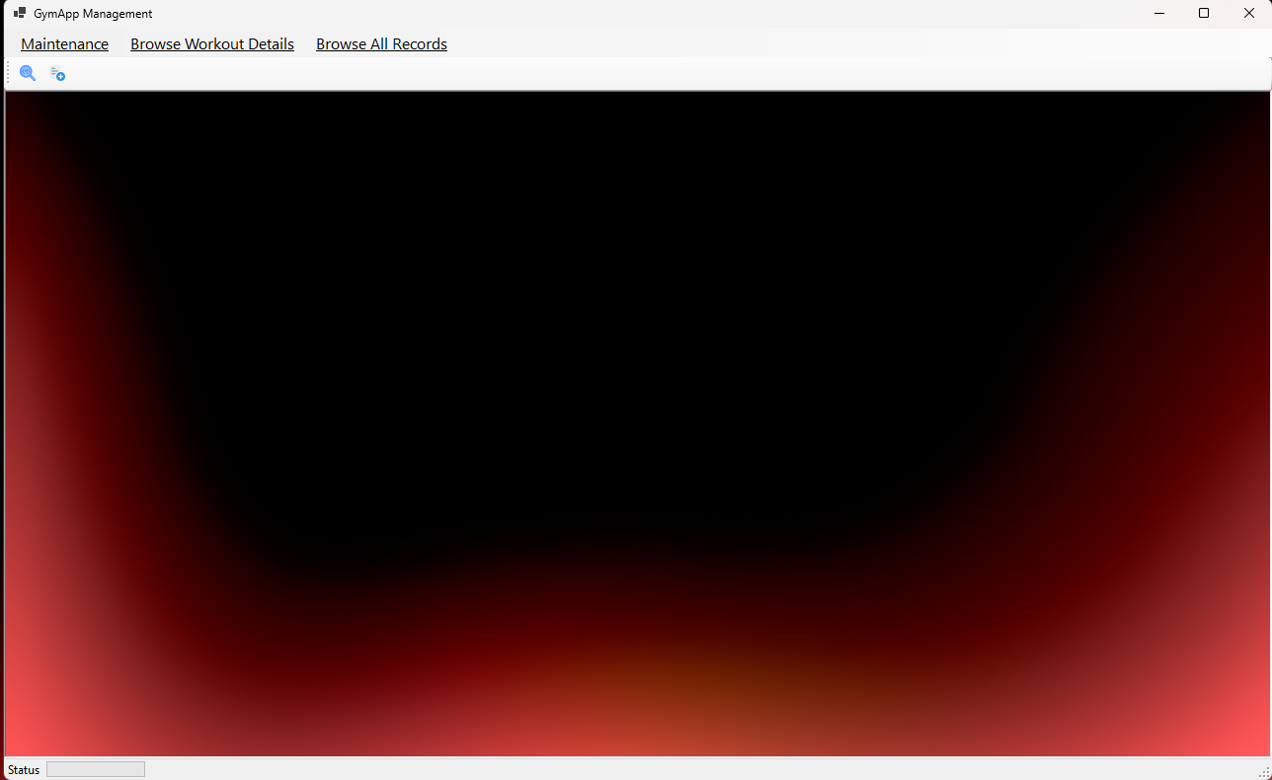
MDI

Slide 17
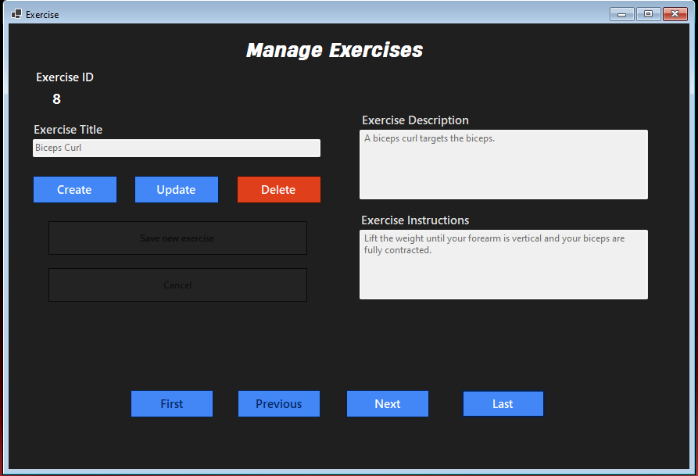
EXERCISE MANAGEMENT

Slide 18
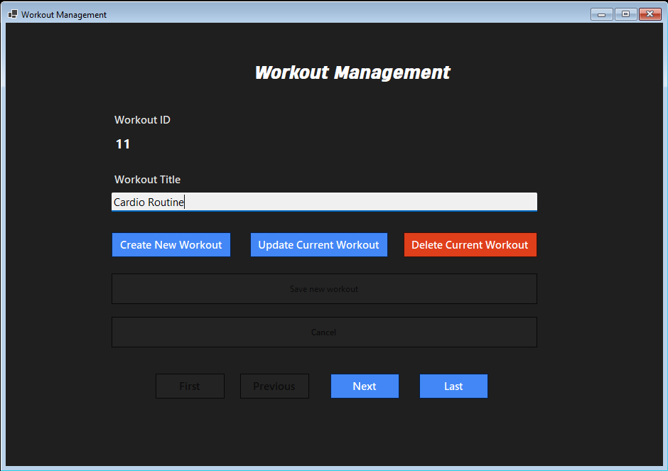
WORKOUT MANAGEMENT

Slide 19
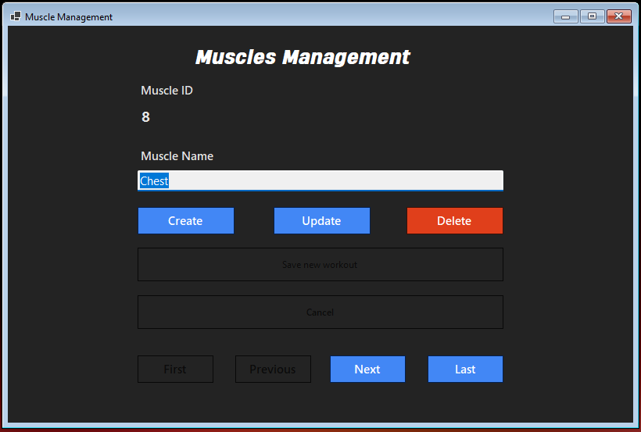
MUSCLE MANAGEMENT

Slide 20
MUSCLE MANAGEMENT

Slide 21
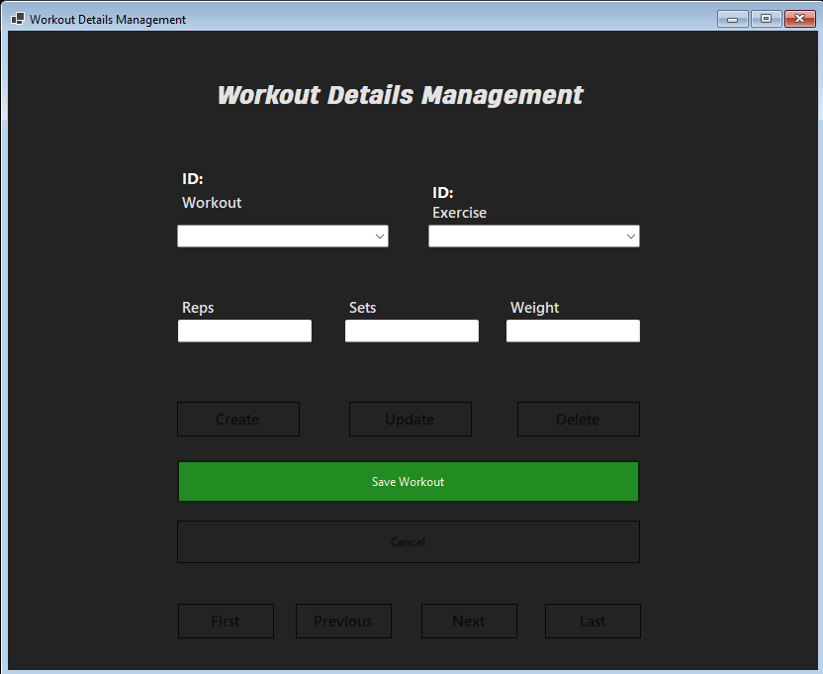
WorkoutExercise Management

Slide 22
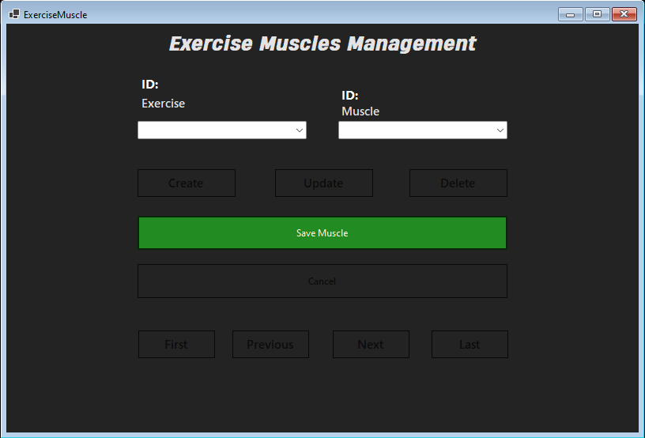
ExerciseMuscle Management

Slide 23
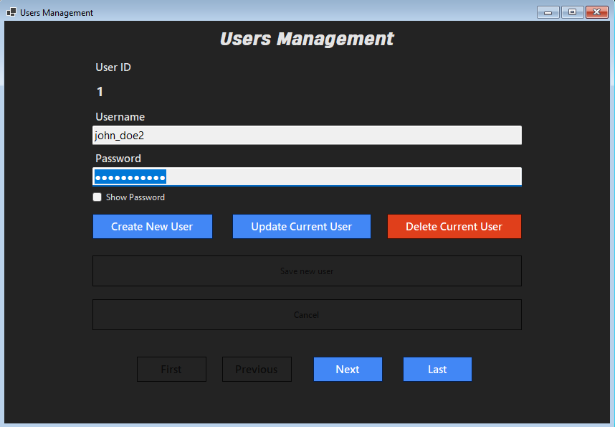
User Management

Slide 24
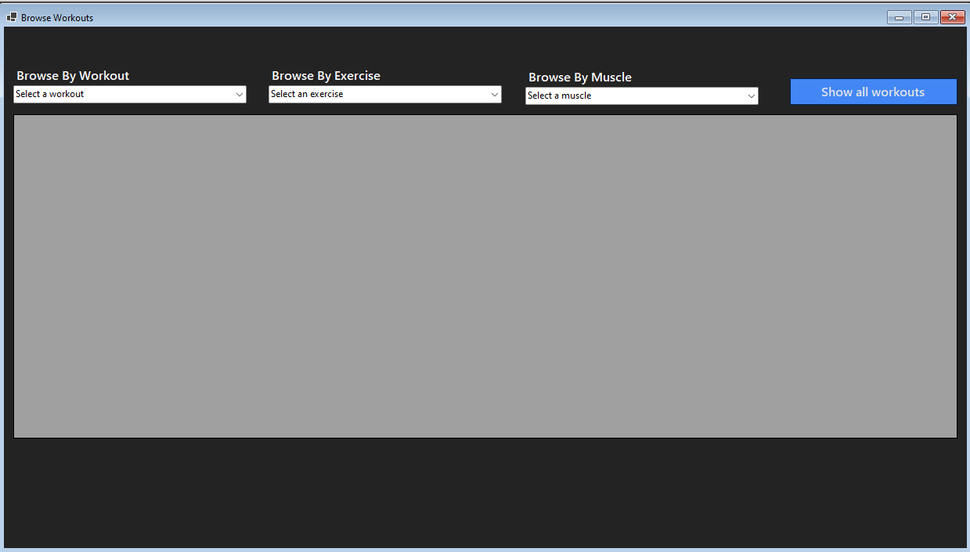
Workout Browser

Slide 25
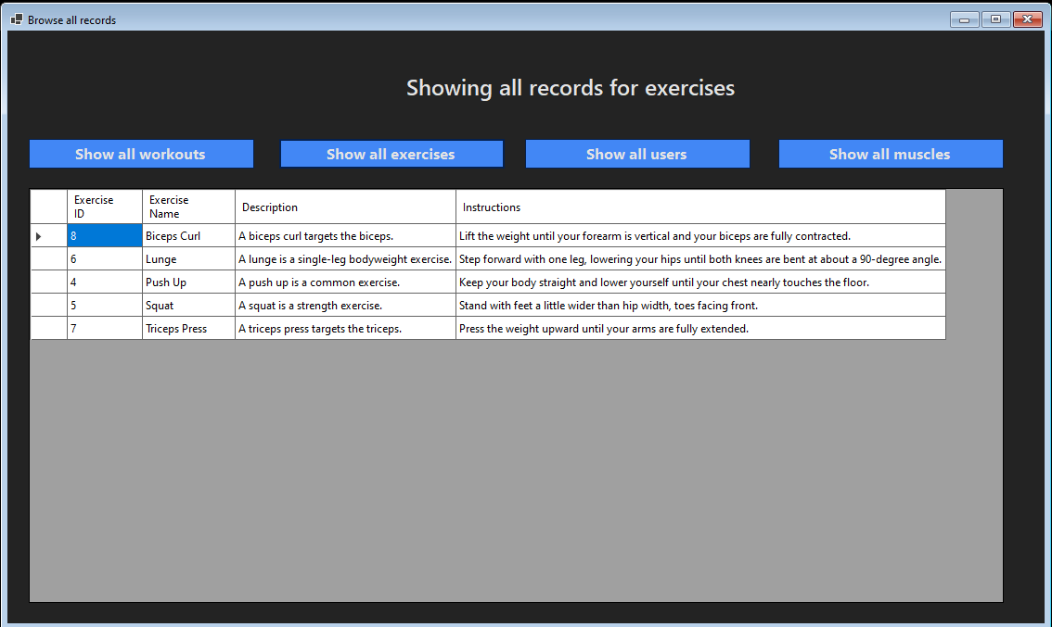
All Tables Browser

Slide 26
Lessons Learned
This project was both demanding and fulfilling. While it required intense effort – I found myself clocking in 15-hour sleep sessions over the past four days – I accomplished approximately 95% of my goals.
Reflecting on the process, I realized I may have allocated excessive time to perfecting the ER diagrams. Transitioning to coding sooner would have been more effective.
However, witnessing the project's growth was immensely rewarding. I really feel the results of all these past months learning programming.
Moving forward, I intend to strike a better balance between planning and execution to avoid burnout. In conclusion, despite the challenges, I am proud of my progress. This project has been a valuable learning experience, underscoring the importance of perseverance and strategic planning.

Slide 27


THANK YOU!
For watching this presentation
jribeiro02@mynbcc.ca
Repository link

